Slide 1
Data Structures & Operators

Slide 2
Data structure
Classification of data structures
Operations on data structure
Stack
Implementation
Operation
Queue
Implementation
Operation
Linked list
Implementation
Operation

Slide 3
Data structures
Way of organizing similar or dissimilar logically related data items into a single unit
Classification of data structure
Based on data type
[ mixture ]
Simple data structure
Compound data structure
Array
Structure
Linear
Non Linear
Stack
Queue
Linked list
Tree
Graph

Slide 4
Based on Memory
Static data structure
Dynamic data structure
Array
Linked list

Slide 5
Static Data Structure
It is associated with primary (main) memory.
Memory allocation done before the execution of the program.
It is fixed.
Example : Array
Dynamic Data Structure
It is associated with secondary (auxiliary) memory.
Memory allocation done during the execution of the program.
It is flexible
Example : linked list, Files

Slide 6
Operations on Data Structure
Traversing
Searching
Inserting
Deleting
Sorting
Merging

Slide 7
1. Traversing
Accessing / visiting / reading all elements of a data structure is called traversing
Example : Reading all the element in an array
2. Searching
Process of finding elements in a data structure is called searching
Two methods :
Linear searching
Binary searching

Slide 8
3. Inserting
Process of adding new elements at a particular location in a data structure is called inserting
Example : Adding new data into an array
4. Deleting
Process of removing a particular element from a data structure is called inserting
Example : delete a data from an array

Slide 9
5. Sorting
Arranging elements in a particular order is called sorting.
Two methods :
Bubble sorting
Selection sorting
5. Merging
Process of combining 2 sorted data structure and form a new one is called merging
Example : combining 2 arrays.

Slide 11
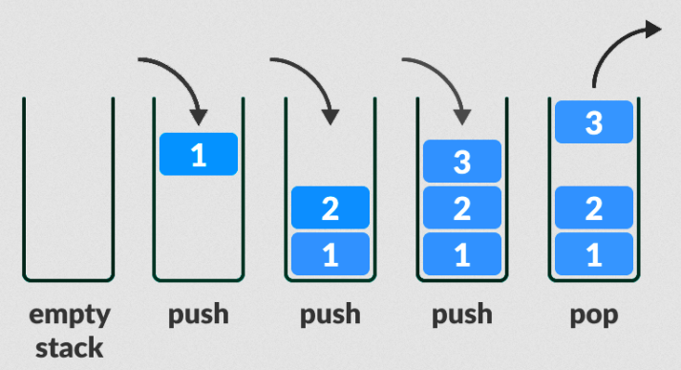
Stack

Slide 12
Stack
Stack is a logical concept
It is a static data structure
The data structure follows “LIFO” principal is known as stack.
LIFO : Last In First Out.
Def :
“ A stack is a linear structure in which items can be added or remove only at one end called TOP ”
Add an item into stack is called PUSH
Remove an item from the stack is called POP

Slide 13
Implementation of stack
Stack can be implemented using array
Initially TOP value is set to -1 [denote stack is empty]
when a data added to the stack, TOP is incremented by 1
Index of 1st element is ‘0’ and last element is ‘N-1’.
3
3
2
2
1
1
0
TOP
0
25
TOP
-1
-1

Slide 14
Operations on stack
PUSH operation
POP operation
PUSH operation
It is the process of adding a new item into the stack
If the stack is full, it makes the stack “overflow”

Slide 15
Algorithm of PUSH Operation
Step 1 : If TOP = N
then print “Overflow” and return
Step 2 : Set TOP = TOP + 1
Step 3 : Set Stack[ TOP ] = item
Step 4 : Stop

Slide 16
Operations on stack
PUSH operation
POP operation
2. POP operation
It is the process of deleting an item from the stack
If the stack is empty, it makes the stack “underflow”

Slide 17
Algorithm of POP Operation
Step 1 : If TOP = Null
then print “Underflow” and return
Step 2 : Set item = Stack[ TOP ]
Step 3 : Set TOP = TOP - 1
Step 4 : Stop

Slide 19
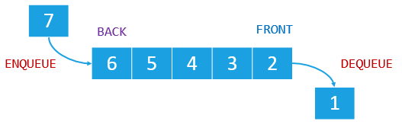
Queue

Slide 20
Queue
Queue is a logical concept
It is a static data structure
The data structure follows “FIFO” principal is known as queue.
FIFO : First In First Out.
Queue have 2 ends
REAR : adding a new item into the queue.
FRONT : Removing an item from the queue.

Slide 21
Implementation of queue
Queue can be implemented using array
New data added at “REAR” end and removed at “FRONT” end.
Initially the value of FRONT and REAR set to -1 [denote queue is empty]
A new data is added to a queue, the REAR is incremented by 1.
A data removed from the queue, the FRONT is incremented by 1.

Slide 22
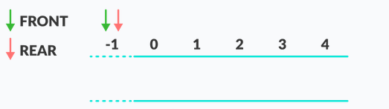
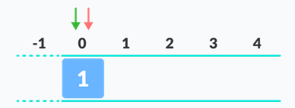
Queue is empty
Add First element to the Queue

Slide 23
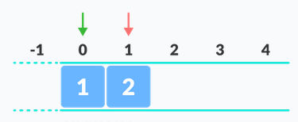
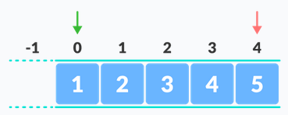
Add second element to the queue
Add more element to the Queue

Slide 24
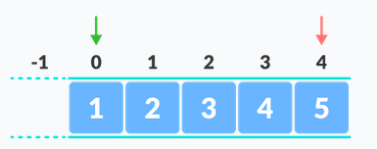
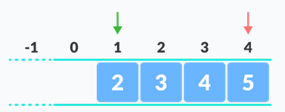
Queue is full
Remove one item from the Queue
[ First added item ]

Slide 25
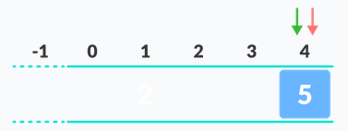
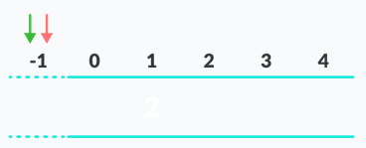
Remove more items [ left 1 item ]
If last item deleted [ empty queue ]

Slide 26
Operations on Queue
Insertion operation
Deletion operation
Insertion operation
It is the process of adding a new item into the queue at the ‘REAR end
If the queue is full, it makes the stack “overflow”

Slide 27
Algorithm of Insertion Operation
Step 1 : If REAR = N-1 or FRONT = REAR + 1
print “Overflow”
goto Step 4
End if
Step 2 : If FRONT = -1 and REAR = -1
Set FRONT = REAR = 0
Else
Set REAR = REAR + 1
End If
Step 3 : Set Queue[ REAR ] = item
Step 4 : Stop

Slide 28
Operations on Queue
Insertion operation
Deletion operation
2. Deletion operation
It is the process of removing an item from the queue at the ‘FRONT’ end
If the queue is empty, it makes the stack “Underflow”

Slide 29
Algorithm of Deletion Operation
Step 1 : If FRONT= -1 or FRONT > REAR
print “Underflow”
Else
Set item = Queue[ FRONT ]
Set FRONT = FRONT + 1
End If
Step 2 : Stop

Slide 31
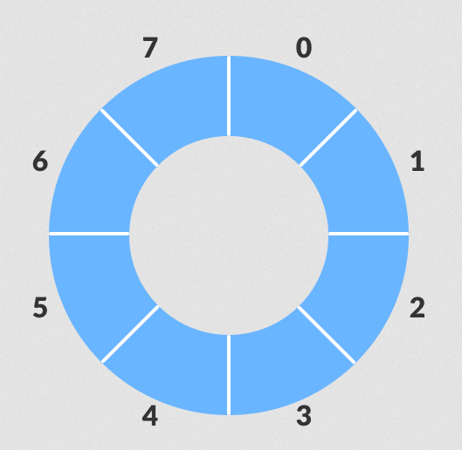
Circular Queue
FRONT
25
25
37
REAR
2
41

Slide 32
Circular Queue
Queue is a logical concept
It is a static data structure
Circular in shape
Def :
“Circular queue is a queue in which the two end points are connected”
Limitations of linear queue can overcome by circular queue.

Slide 34
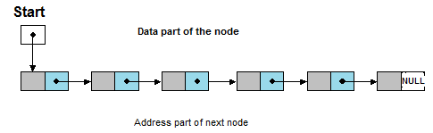
Linked List

Slide 35
Linked List
It is a dynamic data structure
It grow and shrinks as when the new items are added and remove respectively
An element in a linked list is called Node
A node have 2 part : data and address.
Linked list is a collection of nodes
A node contains data and address of next node .
Last node contains data and a null pointer [no address]

Slide 36
Implementation of Linked List
A node consist of data and address of next node
Address is a pointer
Linked list is created with the help of self referential structure
struct node
{
int data;
node *link;
};

Slide 37
1st node is called “Start”. [Special pointer]
1st node is creating using
struct node * start
Or node * start
start

Slide 39
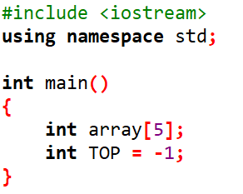
when a data added to the stack, TOP is incremented by 1
4
3
2
1
0
TOP
-1

Slide 41
Implementation of stack
Stack can be implemented using array
Step 1 : Initially TOP value is set to -1 [denote stack is empty]
4
3
2
1
0
TOP
-1

